Slide 1
SAP Fashion Press Event
Stefan Gruler
SAP AG
February 10th, 2011 I Florence, Italy

Slide 2
Key trends are challenging growth Driving the need for constant innovation
Powerful Customers
Mobile Revolution
Globalization and Consolidation
Price and Margin Pressures
Speed to Market
Engage customers with an abundance of options across channels
Consumers are always connected
Global expansion with local assortments
Competition and siloed channel operations have shrunk profitability levels
Shortened selling cycles have challenged traditional buying and distribution strategies
Notes:
Instructions:
Purpose: Introduce key trends for this industry. The trends are categorized in the blue header, and listed under the pictures. Change pictures as appropriate for each category. Note: these trends should lead into a discussion around what solutions SAP can bring to bear. If there are certain trends we cannot address, consider whether you want to highlight them at all.
Questions to help the customer answer/gain agreement to:
What are the key trends which impact your industry?
Quality Check:
Are the trends compelling for a mixed executive audience in this industry?
Are the trends easy to understand in the customer’s language?
Is this depiction on the slide easy for the audience to grasp and understand?
Do the trends effectively set up a story that shows how SAP is better than any alternative?
Content Pointers:
Choose trends that lead into our solution discussion, but are also sharp and interesting and current
Ensure key “stakeholders” – either organizations or categories of companies are represented.
Add explanatory facts and figures (“manifestation”) in the notes area to enliven the discussion with the customer.
Talking points:
Powerful Customers
Customers are connected across every channel and with social media sites are often very active and verbal in their reaction to product and services. Retailers need to engage across all available channels to understand and then promote the image of their brand
Mobile Revolution is a reality with consumers connecting by mobile devices and companies using mobile to make themselves more efficient and connect their people
Globalization pressures remain as large retailers seek to increase market share by geographic expansion. However global companies need to think locally and develop attractive assortments that will appeal to local tastes.
Price and margin pressures remain as economic recovery slowly takes hold; Consumers are looking for good quality at good price and retailers need to develop pricing strategies that support their brand image to attract their target customer. Retailers are constantly looking at costs and efficiencies and brining together their channel operations into one increases service levels and reduces overheads.
Speed to market. Across all subsegments the pace on new product introduction has acclerated to keep customers interested and increase wallet share. This requires very efficient retail processes that are able to handle short product lifecycles and fast distribution from source to consumer.
r

Slide 3
And disrupting traditional retail business models
The future shape of retailing
Multi-Channel Retailing
Shoppers interact through multiple touch points (mobile, web, store, etc) anytime, anywhere
Consumerization, Verticalization and Diversification
Consumers across industries and markets embracing new models combining services and personalization
Real-Time Consumer Insight
Rapid capture, mass customer data analysis and real-time insight and optimization using InMemory and Analytics capabilities
Price and Margin Pressure
…dominate buying process. Continued push for efficient processes, low TCO/ TCI and time to value
Globalization and Market Consolidation
…continue in the Retail industry. Top 10 players worldwide outgrew market in 2009
Notes:
IGD Trends 2011:
2011: the year of online?
International moving up the agenda
Improving returns a continued focus
Engagement the name of the game
A fragile economic outlook
Focus on format and product innovation
Sustainability to remain top of mind
People and skills key to future success
The return of simplicity
Supply chain waste firmly on the industry’s agenda

Slide 4
Retail – a Strategic Industry for SAP
Retail represents a 2 bn € software market (annual license spend on business applications)
4800+ Retailers today use SAP Software worldwide
SAP has defined retail as one of its focus industries
Retail industry priorities are very much in line with SAP‘s strategic direction → Enterprise mobility (Sybase) and real real-time analytics (In-Memory Computing) as two important focus areas
“Retail internet and mobile sales will surpass offline brick and mortar sales globally in the next 5 years.” – Goldman Sachs, 2010
“Multi-channel shoppers spend, on average, 15-30% more with a Retailer than someone who uses only one channel.” – IDC 2010.

Slide 5
Our vision is to deliver leading retail solutions for these multi-industry value chains …
Consumer
Products
Financial
Services
Oil & Gas
Consumer Insight & Predictive Analytics
Travel
Retail
Utilities
Wholesale
Telco
…
…..
Consumer
To help you manage the consumers share of wallet – anywhere, anytime, on any device
Speed
Reach
Personalization

Slide 6
Three Pillars to Capture a Global Market Volume of More than Two Billion Euro
SPEED
REACH
PERSONALIZATION
Demand Driven Supply Network
Deliver on customer service expectations with fast responsive retailing driven by unified channel demand
Unified Customer Channel
Mobile enabled unified channel to reach customers anywhere, anytime, on any device
Customer Insight & Predictive Analytics Bidirectional customer engagement that scales across all channels and brands to drive personalized experiences
RETAIL WITHOUT BOUNDARIES
Providing an efficient, seamless, cross channel capabilities to meet fast changing customer demand
Notes:
SAP’s vision is to provide a unified channel, mobile-enabled retail solution which allows consumer facing companies to support their shoppers anywhere, anytime, on any device while providing a superior retail experience.

Slide 7
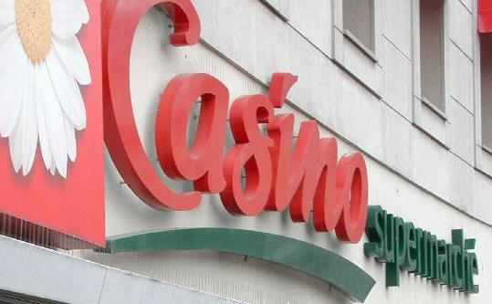
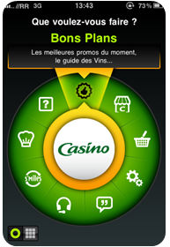
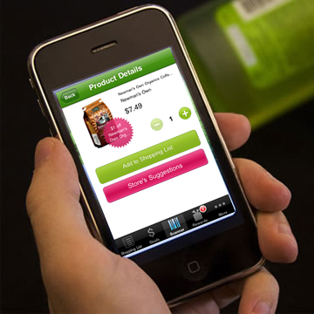
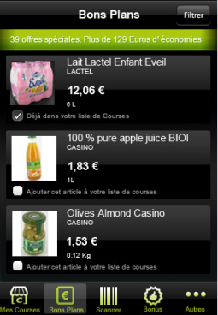
Casino & SAP co-innovation initiative around consumer mobile solution
Project
Co-Innovation Project between SAP and Casino
Consumer Mobile Solution featuring:
Targeted 1-1 Marketing
Personalized Special Offers
Optimized Shopping List
Up- and Cross-Selling
Consumer Analytics
Company Profile
French Grocery Retailer
26,7 bn d’euros revenue (2009)
App. 11 000 stores worldwide, 9 364 in France
7,3 million m² sales area
Mulitple Formats: Neighbourhood stores to Hyper Markets

Slide 8
Precision Retailing and the Mobilized Consumer
Notes:
Good afternoon, I’d like to thank everyone here for your warm welcome and I would like to congratulate the NRF on serving the needs of the retail industry for the past 100 years.
It truly is an exciting accomplishment, and SAP looks forward to remaining a part of your continued success for the next 100 years!
But, getting back to today – I’ve got to tell you - I am pleased to be here with one of our great customers - Groupe Casino.
Together, we are going to share with you how advances in technology and consumer power are allowing retailers to innovate and deliver a powerful and personalized customer experience.
ANNOUNCER:
Ladies and Gentlemen, please welcome Mr. Bob Courteau, President of SAP America
AV: Cue exciting music while Bob walks onto the stage.

